Slide 1
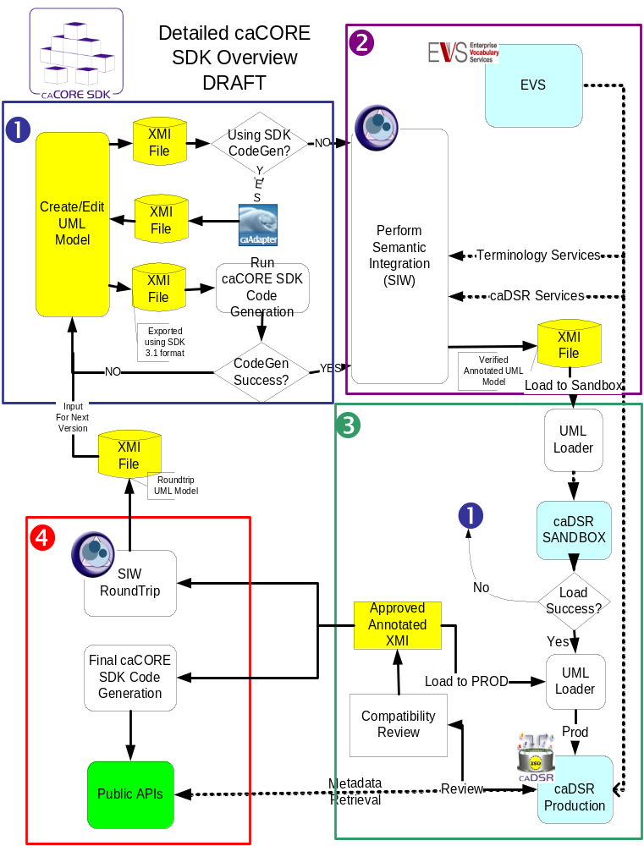
caCORE Process
Design system and draw model
(UML tool)
Annotate model
(Semantic Integration)
Register metadata
(UML Loader)
Generate and deploy system (Code Generator)

